Slide 1
Managerial Communication
Session 13
7th July

Slide 2
What is Communication?
Communication is the transfer and understanding of meaning.
This means that if no information or ideas have been conveyed, communication hasn't taken place.
For communication to be successful, the meaning must be imparted and understood.
Managerial communication includes: interpersonal communication—communication between two or more people—and organizational communication—all the patterns, networks, and systems of communication within an organization

Slide 3
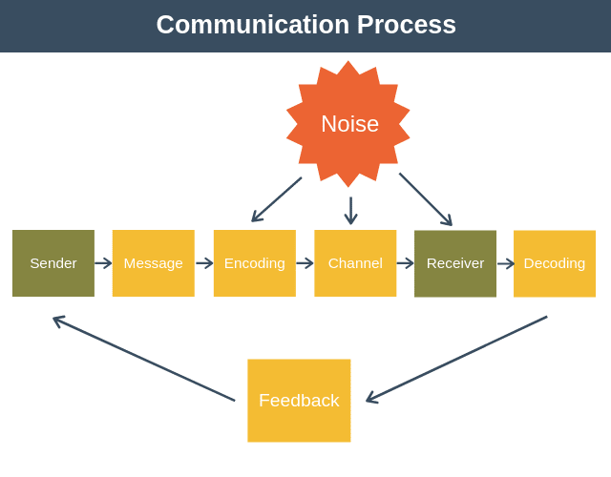
The Process of Interpersonal Communication

Slide 4
Before communication can take place, a purpose, expressed as a message to be conveyed, must exist. It passes between a source (the sender) and a receiver.
The message is converted to symbolic form (called encoding) and passed by way of some medium (channel) to the receiver, who retranslates the sender's message (called decoding).
The result is the transfer of meaning from one person to another
Noise: the entire communication process is susceptible to noise—disturbances that interfere with the transmission, receipt, or feedback of a message. Typical examples of noise include illegible print, phone static, inattention by the receiver, or background sounds of machinery or co-workers

Slide 5
A sender initiates a message by encoding a thought.
Four conditions influence the effectiveness of that encoded message:
the skills,
attitudes, and
knowledge of the sender, and
the sociocultural system

Slide 6
A message is the actual physical product encoded by the source.
It can be the written document, the oral speech, and even the gestures and facial expressions we use.
The message is affected by the symbols used to transfer meaning (words, pictures, numbers, etc.), the content of the message itself, and the decisions that the sender makes in selecting and arranging both the symbols and the content.

Slide 7
The channel chosen to communicate the message also has the potential to be affected by noise. Whether it's a face-to-face conversation, an e-mail message, or a company-wide memorandum, distortions can and do occur.

Slide 8
The receiver is the individual to whom the message is directed.
Before the message can be received, however, the symbols in it must be translated into a form that the receiver can understand. This is the decoding of the message.
Just as the sender was limited by his or her skills, attitudes, knowledge, and sociocultural system, so is the receiver.
And just as the sender must be skillful in writing or speaking, the receiver must be skillful in reading or listening.
A person's knowledge influences his or her ability to receive.
Moreover, the receiver's attitudes and sociocultural background can distort the message.

Slide 9
Methods of Communicating Interpersonally
Feedback—how quickly can the receiver respond to the message?
Complexity capacity—can the method effectively process complex messages?
Breadth potential—how many different messages can be transmitted using this method?
Confidentiality—can communicators be reasonably sure their messages are received only by those intended?
Encoding ease—can sender easily and quickly use this channel?
Decoding ease—can receiver easily and quickly decode messages?
Time-space constraint—do senders and receivers need to communicate at the same time and in the same space?
Cost—how much does it cost to use this method?
Interpersonal warmth—how well does this method convey interpersonal warmth?
Formality—does this method have the needed amount of formality?
Scanability—does this method allow the message to be easily browsed or scanned for relevant information?
Time of consumption—does the sender or receiver exercise the greater control over when to deal with the message?

Slide 10
Non-verbal communication
Communication transmitted without words.
Some of the most meaningful communications are neither spoken nor written.
A loud siren or a red light at an intersection tells you something without words

Slide 11
Body language
It refers to gestures, facial expressions, and other body movements that convey meaning.
A person frowning "says" something different from one who's smiling.
Hand motions, facial expressions, and other gestures can communicate emotions or temperaments such as aggression, fear, shyness, arrogance, joy, and anger

Slide 12
Verbal intonation
It refers to the emphasis someone gives to words or phrases that conveys meaning
A soft, smooth vocal tone conveys interest and creates a different meaning from one that is abrasive and puts a strong emphasis on saying the last word

Slide 13
Barriers to Effective Interpersonal Communication

Slide 14
Filtering
Filtering is the deliberate manipulation of information to make it appear more favorable to the receiver. For example, when a person tells his or her manager what the manager wants to hear, that individual is filtering information. As information is communicated up through organizational levels, it's condensed and synthesized by senders so those on top don't become overloaded with information.
The extent of filtering tends to be a function of the number of vertical levels in the organization and the organizational culture. The more vertical levels there are in an organization, the more opportunities there are for filtering.
As organizations become less dependent on strict hierarchical arrangements and instead use more collaborative, cooperative work arrangements, information filtering may become less of a problem.
Also, the ever-increasing use of e-mail to communicate in organizations reduces filtering because communication is more direct as intermediaries are bypassed.
Also, the organizational culture encourages or discourages filtering by the type of behavior it rewards. The more that organizational rewards emphasize style and appearance, the more that managers will be motivated to filter communications in their favor

Slide 15
Selective perception
Selective perception is when people selectively interpret what they see or hear on the basis of their interests, background, experience, and attitudes.
The receiver in the communication process selectively sees and hears communications depending on his or her needs, motivations, experience, background, and other personal characteristics.
The receiver also projects his or her interests and expectations into communications as they are decoded.

Slide 16
Emotions
How a receiver feels when a message is received influences how he or she interprets it.
You'll often interpret the same message differently, depending on whether you're happy or distressed.
Extreme emotions are most likely to hinder effective communication. In such instances, we often disregard our rational and objective thinking processes and substitute emotional judgments.
It's best to avoid reacting to a message when you're upset because you're not likely to be thinking clearly.

Slide 17
Information Overload
When the information we have to work with exceeds our processing capacity.
What happens when individuals have more information than they can sort and use? They tend to select out, ignore, pass over, or forget information. Or they may put off further processing until the overload situation is over.
Regardless, the result is lost information and less effective communication.

Slide 18
Defensiveness
When people feel that they're being threatened, they tend to react in ways that reduce their ability to achieve mutual understanding.
That is, they become defensive—engaging in behaviors such as verbally attacking others, making sarcastic remarks, being overly judgmental, and questioning others' motives

Slide 19
Language
Words mean different things to different people.
Age, education, and cultural background are three of the more obvious variables that influence the language a person uses and the definitions he or she gives to words.

Slide 20
National culture
Communication differences can also arise from the different languages that individuals use to communicate and the national culture of which they are a part.
Interpersonal communication isn't conducted the same way around the world. For example, let's compare countries that place a high value on individualism (such as the United States) with countries where the emphasis is on collectivism (such as Japan)

Slide 21
Overcoming the Barriers to Effective Interpersonal Communication

Slide 22
Use Feedback
Many communication problems can be directly attributed to misunderstandings and inaccuracies.
These problems are less likely to occur if the manager uses the feedback loop in the communication process.
This feedback can be verbal or nonverbal.

Slide 23
Simplify language
Because language can be a barrier, managers should choose words and structure their messages in ways that will make those messages clear and understandable to the receiver.
The manager needs to simplify his or her language and consider the audience to whom the message is directed so that the language can be tailored to the receivers.
Effective communication is achieved when a message is both received and understood.
Understanding is improved by simplifying the language used in relation to the audience intended.

Slide 24
Listen actively
Listening is an active search for meaning, whereas hearing is passive.
In listening, two people are engaged in thinking: the sender and the receiver.
Listening demands intellectual effort.
Active listening is listening for full meaning without making premature judgments or interpretations, demands total concentration.
Active listening is enhanced by developing empathy with the sender—that is, by placing yourself in the sender's position.

Slide 25
Constrain emotions
We know that emotions can severely cloud and distort the transference of meaning.
A manager who is emotionally upset over an issue is more likely to misconstrue incoming messages and fail to communicate his or her outgoing messages clearly and accurately.
In such case, the manager should refrain from communicating until he or she has regained composure

Slide 26
Watch nonverbal cues
If actions speak louder than words, then it's important to watch your actions to make sure they align with and reinforce the words that go along with them.
The effective communicator watches his or her nonverbal cues to ensure that they convey the desired message.

Slide 27
Organizational communication

Slide 28
Formal Versus Informal Communication
Formal communication refers to communication that follows the official chain of command or is part of the communication required to do one's job. Any communication that takes place within prescribed organizational work arrangements would be classified as formal
Informal communication is organizational communication that is not defined by the organization's structural hierarchy. It permits employees to satisfy their need for social interaction

Slide 29
Direction of Communication Flow
Any communication that flows downward from a manager to employees is downward communication. Downward communication is used to inform, direct, coordinate, and evaluate employees.
Upward communication is communication that flows upward from employees to managers. It keeps managers aware of how employees feel about their jobs, their co-workers, and the organization in general. Managers also rely on upward communication for ideas on how things can be improved.

Slide 30
Lateral communication: Communication that takes place among any employees on the same organizational level is called lateral communication. Example: Cross-functional teams
Diagonal communication is communication that cuts across both work areas and organizational levels.

Slide 31
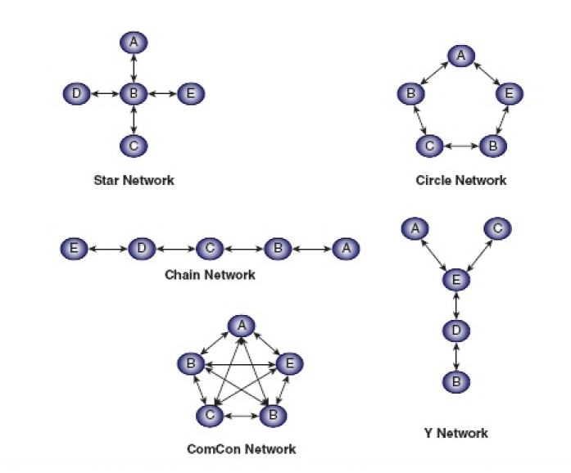
Organizational communication networks

Slide 32
In the chain network, communication flows according to the formal chain of command, both downward and upward.
The wheel network represents communication flowing between a clearly identifiable and strong leader and others in a work group or team. The leader serves as the hub through whom all communication passes.
Finally, in the all-channel network, communication flows freely among all members of a work team

Slide 33
Grapevine
The informal organizational communication network
Example: Rumours

